Slide 1





About the Mission
Systemic Gaps Affecting Nursing Quality
Competency Certification – A Step Towards Solutions
Inside the Certification Centre
Why Hire Certified Nurses

Slide 2
About the Mission
Systemic Gaps Affecting Nursing Quality
Competency Certification – A Step Towards Solutions
Inside the Certification Centre
Why Hire Certified Nurses

Slide 3







Mission has 7 key pillars for improving nursing standards
Quality Assurance
Quality Improvement
Continuous Nursing Education
Competency Certifications
Digital Platform
E-Kshamata
Digital Library –
E-gyanodaya
Independent Quality Rating by Quality Council of India
on established standards of nursing education.
Learning Opportunities for professional development of nurses to enhance knowledge and skills through PRERNA.
e-learning platform for pre and In service nurses through competency-based modules and personalized learning pathways.
Digital library enabling nursing students and faculty instant access to the large repository of nursing books and journals.
Mentoring of peers to achieve quality standards through Mentor Mentee program.
Competency certification related to job readiness for newer opportunities in nursing career.
End to end digital solution catering to various needs of nursing institutes, students and professionals.
Institutional Strengthening
Nursing Career Enhancement
Digital Initiatives

Slide 4
About the mission
Systemic Gaps Affecting Nursing Quality
Competency Certification – A Step Towards Solutions
Inside the Certification Centre
Why Hire Certified Nurses

Slide 5




Low nursing quality persists due to a self-reinforcing vicious cycle
Demand
Supply
1
2
Low salaries for nurses
in the market
Expected salary
of nurses
Poor
quality of
incoming students
Salary of Nurses
Vicious
Cycle
Current salary
of nurses
Poor quality of nursing professionals
Poor quality institutes with no incentive to invest in quality
Quantity of Nurses
4
3

Slide 6
About the Mission
Systemic Gaps Affecting Nursing Quality
Competency Certification: A Step Towards Solutions
Inside the Certification Centre
Why Hire Certified Nurses

Slide 7





Competency certification breaks the cycle with rigorous, standardised testing and providing a trusted measure of skill
Identifies skilled nurses through objective, transparent evaluation
Builds trust for employers and incentivises skill development
Designed by experts, benchmarked to national standards

Slide 8

Basic midwifery skills are certified through a robust framework
# | Competency Descriptions | Levels
1 | Assessment of Labor Progress: Vaginal Examination & Partograph Plotting | 1
2 | Conducting a Safe and Respectful Normal Vaginal Delivery | 2
3 | Prevention of Postpartum Hemorrhage through Active Management of Third Stage of Labor (AMTSL) | 1
4 | Immediate Postpartum Monitoring of Mother and Newborn (Stage 4 Care) | 2
6 | Recognition and Emergency Management of Postpartum Hemorrhage (PPH) | 1
7 | Infection Control Practices, Biomedical Waste Handling, and WASH in Clinical Settings | 2
8 | Providing Essential Care to Newborns: Thermal Protection, Feeding, and Early Assessment | 2
9 | Safe Administration of Injectables, Intravenous Cannulation, and Fluid | 2
Computer
Based Test
1
Skill-Assessment
Scheme
objectives
Beneficiary and Benefits
Eligibility proofs
Notes:
Put incons

Slide 9


Basic midwifery skills are certified through a robust framework
# | Topics | Procedures
1 | Basic Skills | 1) Monitoring Temperature and Blood Pressure
2 |  | 2) Assessing Height and weight and calculating BMI
3 |  | 3) Administration of Medication - IM
4 |  | 4) IV cannulation
6 | Intranatal Care - A | 1) Plotting and interpreting partograph
7 |  | 2)Assisting/conducting normal vaginal delivery -Management of 2nd stage of labor
8 | Antenatal Care | 1) Abdominal Assessment- Palpation, estimation of gestational week as per fundal height and assessing FHS
9 |  | 2) Per vaginal examination-Assessing cervical dilation and station
10 | Infection Prevention | 1) Handwashing Procedure
11 |  | 2) Wearing PPE-Donning and Doffing of PPE
12 |  | 3) Preparation of 0.5% Chlorine Solution & Processing of Instruments
13 |  | 4) Segregation & disposal of biomedical waste as per BMW guidelines
Computer
Based Test
Skill-Assessment
2
Scheme
objectives
Beneficiary and Benefits
Eligibility proofs
Notes:
Put incons

Slide 10
Basic midwifery skills are certified through a robust framework
# | Topics | Procedures
14 | Intranatal care - B | 1) Essential Newborn Care (ENBC)
15 | Post Partum Complication management | 1) Management of (PPH) - bimanual compression
16 | Intranatal care - C | 1) Active Management of 3rd stage of labor- AMTSL
17 |  | 2) Episiotomy Suturing and Care
18 | New Born Care | 1) Newborn Assessment - anthropometric measurements - length, weight, Head circumference and chest circumference
19 |  | 2) Newborn Resuscitation (NBR)
Computer
Based Test
Skill-Assessment
2
Scheme
objectives
Beneficiary and Benefits
Eligibility proofs
Notes:
Put incons

Slide 11


Each nurse undergoes two rigorous rounds of assessment
Computer-Based Test
Skill Assessment
90 Multiple Choice Questions
90 minutes
Auto-proctored and digitally scored
18 Procedures; 8 stations
20 minutes/ station
Remote evaluation by trained assessors
Remote Proctoring & Evaluation mechanism enables standardized and fair assessments

Slide 12
About the Mission
Systemic Gaps Affecting Nursing Quality
Competency Certification – A Step Towards Solutions
Inside the Certification Centre
Why Hire Certified Nurses

Slide 13
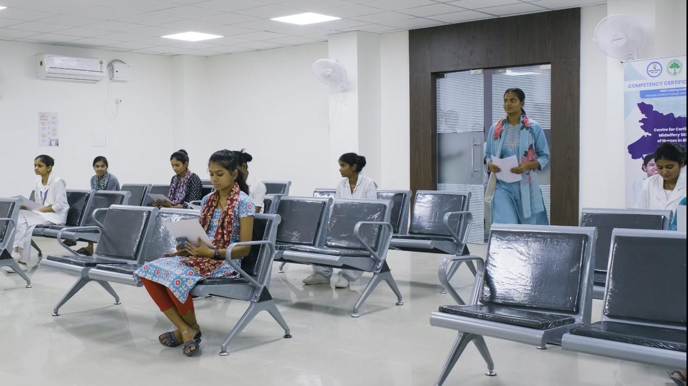

Here’s a glimpse of first certification centre in action
Reception / Waiting Area
Computer-Based Testing Lab

Slide 14
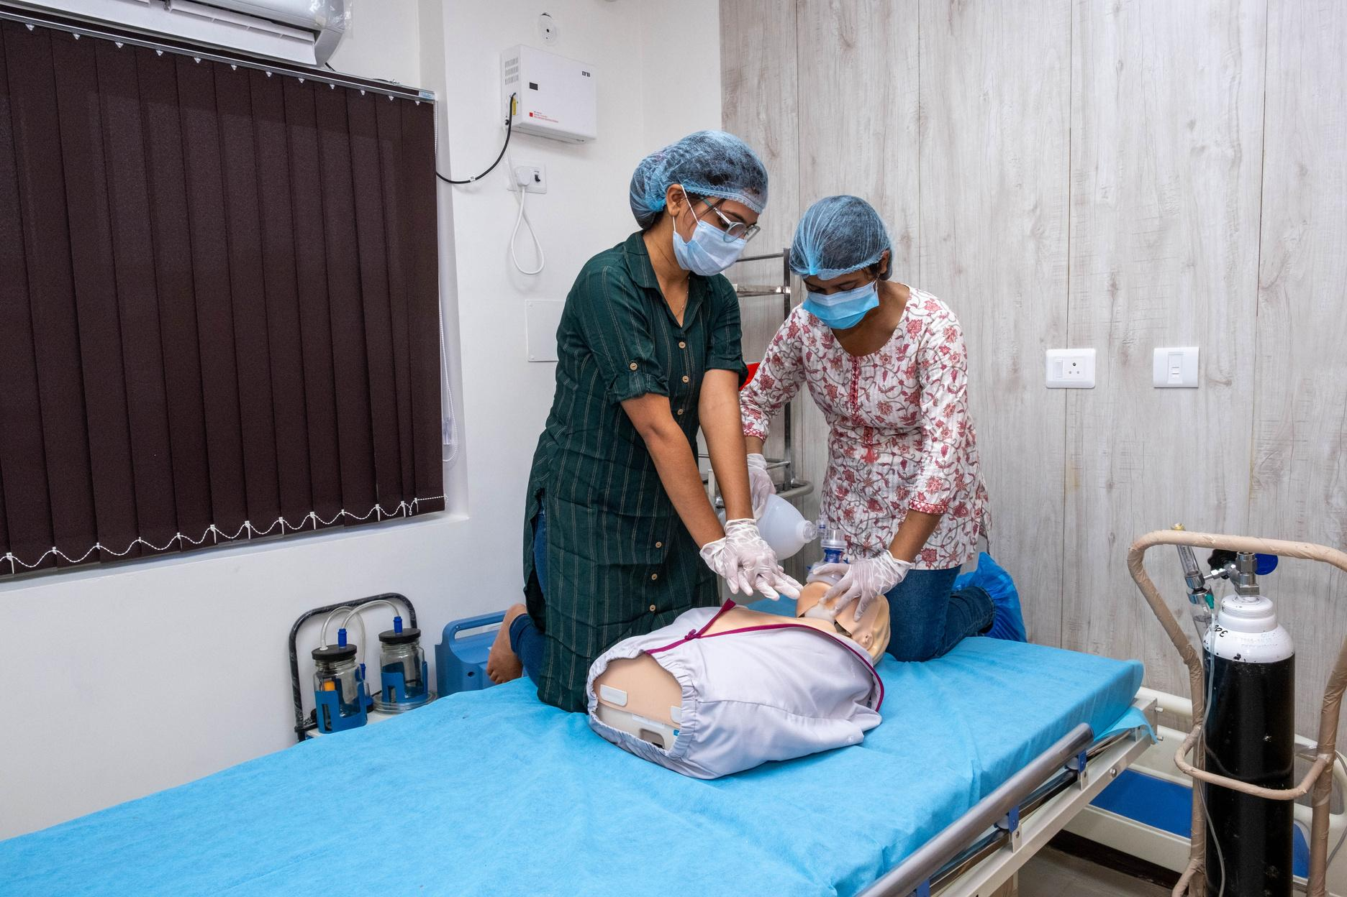

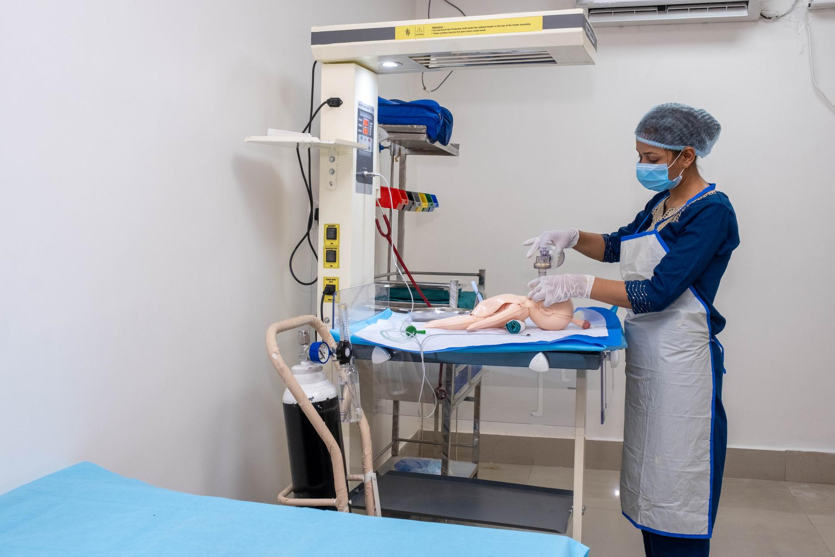
Here’s a glimpse of first certification centre in action
Skill-Based Testing Labs

Slide 15
About the Mission
Systemic Gaps Affecting Nursing Quality
Competency Certification – A Step Towards Solutions
Inside the Certification Centre
Why Hire Certified Nurses

Slide 16




Hiring certified nurses reduces cost, saves time, and improves outcomes
Time Saved
Cost Reduction
Spend less time on onboarding and retraining
Minimise recruitment and training expenses with pre-evaluated candidates
Quality Assurance
Workforce Fit
Hire with confidence –every nurse is certified through a rigorous, unbiased process
Improve retention by selecting candidates best suited for hospital environments

Slide 17




Help Build - One Nurse at a Time
Share your upcoming hiring requirements
Get regular updates on new certified batches
Let’s build a stronger healthcare system together

Slide 18
Thank You

